Slide 1
Introduction to
Computer Vision
Jacob Trombetta

Slide 2
How can you teach a computer to catch?

Slide 3
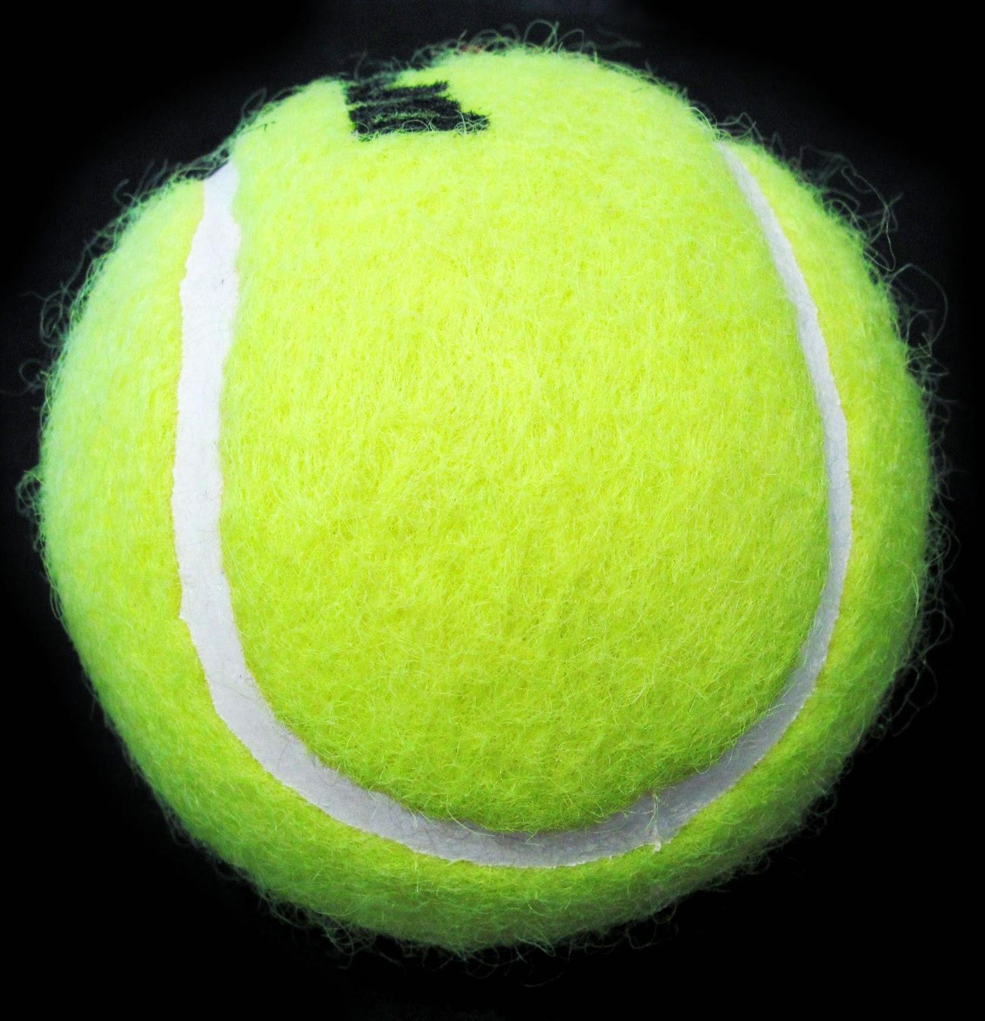
How can you teach a computer to catch?
Tennis ball by Pixleyes, retrieved from http://www.pxleyes.com/guide/35948/the-making-of-Rough-Ball.html. Copyright 2015 by Pxleyes.

Slide 4
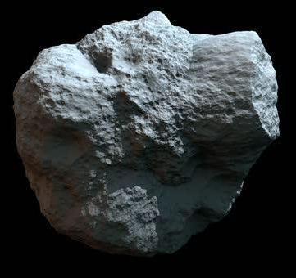
How can you teach a computer to catch?
Tennis ball by Pixleyes, retrieved from http://www.pxleyes.com/guide/35948/the-making-of-Rough-Ball.html. Copyright 2015 by Pxleyes.
Asteroidl by Shutterstock, retrieved from http://ak5.picdn.net/shutterstock/videos/8538925/thumb/1.jpg. Copyright 2017 by Shutterstock.

Slide 5

How can you teach a computer to catch?
Tennis ball by Pixleyes, retrieved from http://www.pxleyes.com/guide/35948/the-making-of-Rough-Ball.html. Copyright 2015 by Pxleyes.
Asteroidl by Shutterstock, retrieved from http://ak5.picdn.net/shutterstock/videos/8538925/thumb/1.jpg. Copyright 2017 by Shutterstock.
Football spiral by Envato, retrieved from https://videohive.net/item/football-spiral-animation-3-angles/155585. Copyright 2017 by Envato.

Slide 6
Goals of computer vision
Notes:
Example: throw a football (some object) for someone to catch.
What process did the human go through to catch that ball?
You see the object, you track the object, you understand you need to catch the object
How can we tell a computer to do that?
CV - how do I interpret images to extract meaning of what it is?

Slide 7
Goals of computer vision
Seeing
Notes:
Example: throw a football (some object) for someone to catch.
What process did the human go through to catch that ball?
You see the object, you track the object, you understand you need to catch the object
How can we tell a computer to do that?
CV - how do I interpret images to extract meaning of what it is?

Slide 8
Goals of computer vision
Seeing
Tennis ball by Pixleyes, retrieved from http://www.pxleyes.com/guide/35948/the-making-of-Rough-Ball.html. Copyright 2015 by Pxleyes.
Asteroidl by Shutterstock, retrieved from http://ak5.picdn.net/shutterstock/videos/8538925/thumb/1.jpg. Copyright 2017 by Shutterstock.
Notes:
Example: throw a football (some object) for someone to catch.
What process did the human go through to catch that ball?
You see the object, you track the object, you understand you need to catch the object
How can we tell a computer to do that?
CV - how do I interpret images to extract meaning of what it is?

Slide 9
Goals of computer vision
Seeing
Describing
Tennis ball by Pixleyes, retrieved from http://www.pxleyes.com/guide/35948/the-making-of-Rough-Ball.html. Copyright 2015 by Pxleyes.
Asteroidl by Shutterstock, retrieved from http://ak5.picdn.net/shutterstock/videos/8538925/thumb/1.jpg. Copyright 2017 by Shutterstock.
Notes:
Example: throw a football (some object) for someone to catch.
What process did the human go through to catch that ball?
You see the object, you track the object, you understand you need to catch the object
How can we tell a computer to do that?
CV - how do I interpret images to extract meaning of what it is?

Slide 10
Goals of computer vision
Seeing
Describing
Tennis ball Rock
Tennis ball by Pixleyes, retrieved from http://www.pxleyes.com/guide/35948/the-making-of-Rough-Ball.html. Copyright 2015 by Pxleyes.
Asteroidl by Shutterstock, retrieved from http://ak5.picdn.net/shutterstock/videos/8538925/thumb/1.jpg. Copyright 2017 by Shutterstock.
Notes:
Example: throw a football (some object) for someone to catch.
What process did the human go through to catch that ball?
You see the object, you track the object, you understand you need to catch the object
How can we tell a computer to do that?
CV - how do I interpret images to extract meaning of what it is?

Slide 11
Goals of computer vision
Seeing
Describing
Understanding
Tennis ball Rock
Tennis ball by Pixleyes, retrieved from http://www.pxleyes.com/guide/35948/the-making-of-Rough-Ball.html. Copyright 2015 by Pxleyes.
Asteroidl by Shutterstock, retrieved from http://ak5.picdn.net/shutterstock/videos/8538925/thumb/1.jpg. Copyright 2017 by Shutterstock.
Notes:
Example: throw a football (some object) for someone to catch.
What process did the human go through to catch that ball?
You see the object, you track the object, you understand you need to catch the object
How can we tell a computer to do that?
CV - how do I interpret images to extract meaning of what it is?

Slide 12
Goals of computer vision
Seeing
Describing
Understanding
Tennis ball Rock
Catch Move
Tennis ball by Pixleyes, retrieved from http://www.pxleyes.com/guide/35948/the-making-of-Rough-Ball.html. Copyright 2015 by Pxleyes.
Asteroidl by Shutterstock, retrieved from http://ak5.picdn.net/shutterstock/videos/8538925/thumb/1.jpg. Copyright 2017 by Shutterstock.
Notes:
Example: throw a football (some object) for someone to catch.
What process did the human go through to catch that ball?
You see the object, you track the object, you understand you need to catch the object
How can we tell a computer to do that?
CV - how do I interpret images to extract meaning of what it is?

Slide 13
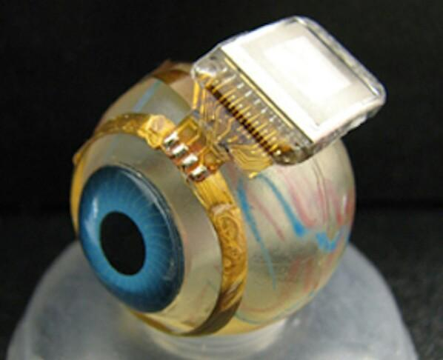
How can a computer see?
Bionic Eye by Carnegie Mellon, retrieved from http://www.jlaya.com/implante-de-retina-2/. Copyright 2012 by Carnegie Mellon.
Notes:
Hardware problem that has had much success.
How do we record the distribution of photons?
We’ve been doing that since the 19th century with images.
A large percentage of our brain is dedicated to understanding images.

Slide 14
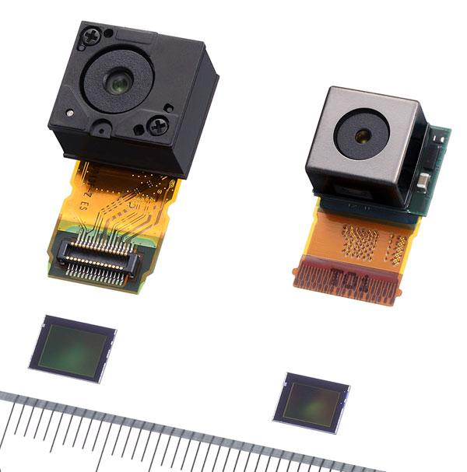
The image sensor
"Exmor" CMOS image sensor by Sony Corporation, retrieved from http://www.dailymobile.net/2008/11/14/sony-commercializes-worlds-first-industry-leading-resolution-1225-megapixel-cmos-image-sensor-exmor-for-mobile-phones/. Copyright 2008 by Sony Corporation.
Notes:
CCD, CMOS sensors

Slide 15

Pixels
TFT Bildschirm RGB Pixel by Devcore, retrieved from https://commons.wikimedia.org/wiki/File:TFT_Bildschirm_RGB_Pixel.JPG. File is made available under the Creative Commons CC0 1.0 Universal Public Domain Dedication.
Notes:
Pixels - typically between [0-255]
Normalized between [0, 1] or [-1,1]

Slide 16
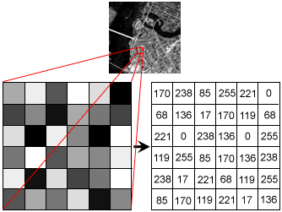
Pixel values by Naushadsblog, retrieved from https://naushadsblog.wordpress.com/2014/02/10/image-processing-and-computer-vision-in-java-point-operators-part-2histogram-equalization/. Copyright 2014 by Naushadsblog.
Notes:
Computer vision is not image processing.
Goal of image processing is produce an image.
Goal of computer vision is produce understanding.

Slide 17
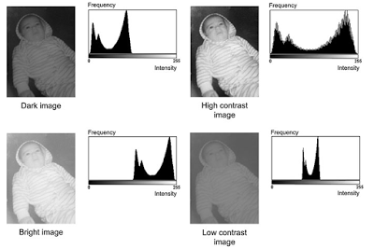
Fig. 4.9 Four images and their respective histograms by what-when-how, retrieved from http://what-when-how.com/introduction-to-video-and-image-processing/point-processing-introduction-to-video-and-image-processing-part-2/. Copyright 2017 by what-when-how.
Notes:
Computer vision is not image processing.
Goal of image processing is produce an image.
Goal of computer vision is produce understanding.

Slide 18
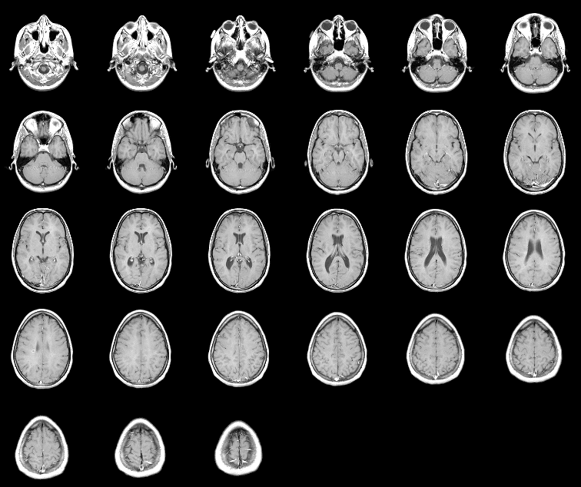
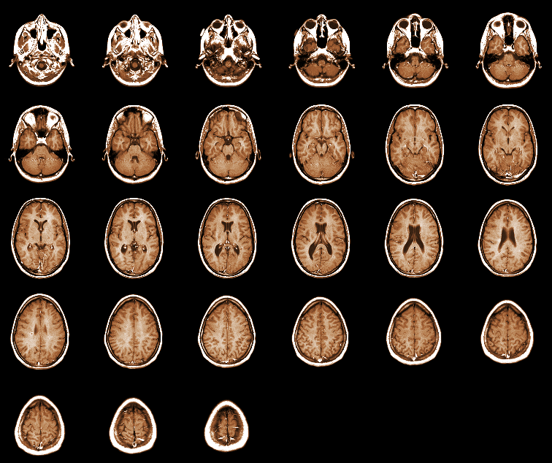
How can a computer describe what it sees?
Horizontal Slices of a 3-dimensional MRI data set by Mathworks, retrieved from https://www.mathworks.com/help/images/examples/exploring-slices-from-a-3-dimensional-mri-data-set.html?requestedDomain=www.mathworks.com. Copyright 2017 by Mathworks.
Notes:
Computer vision is not image processing.
Goal of image processing is produce an image.
Goal of computer vision is produce understanding.

Slide 19
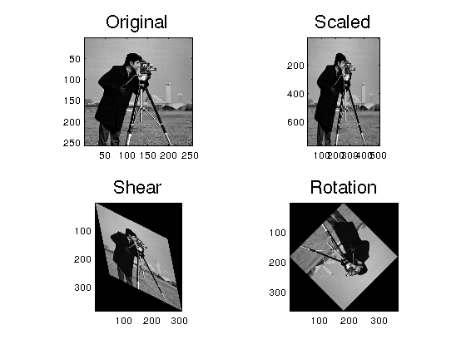
Transformations
Transformations by unknown author, retrieved from https://www.unioviedo.es/compnum/labs/lab05_interpol_images/lab05_interpol_images.html. Copyright 2017 by unknown author.

Slide 20

Panorama
Banner by EasyPano, retrieved from http://www.easypano.com/panorama-software.html. Copyright 2017 by EasyPano.

Slide 21
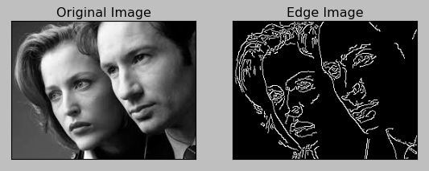
Edge detection
Canny Edge Detection with Mulder and Scully by BogoToBogo, retrieved from http://www.bogotobogo.com/python/OpenCV_Python/python_opencv3_Image_Canny_Edge_Detection.php. Copyright 2008 by BogoToBogo.

Slide 22
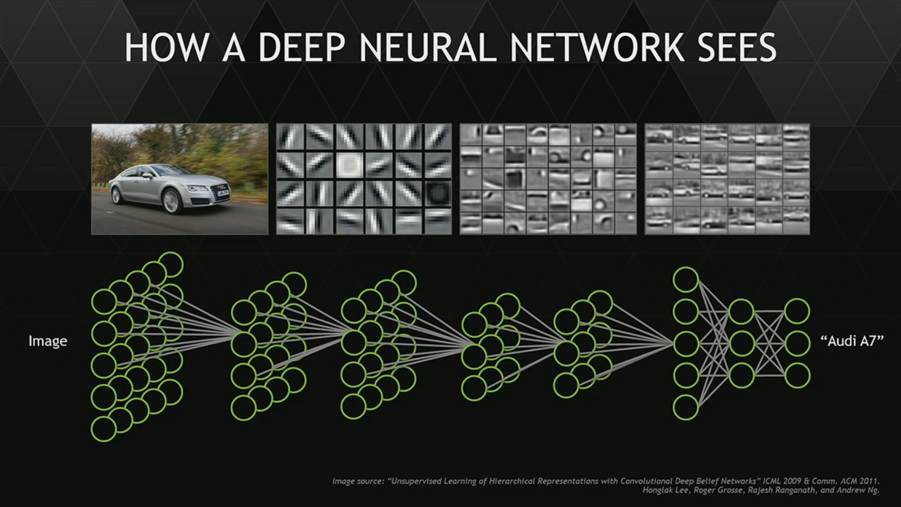
*nothing on this slide was made by me

Slide 23
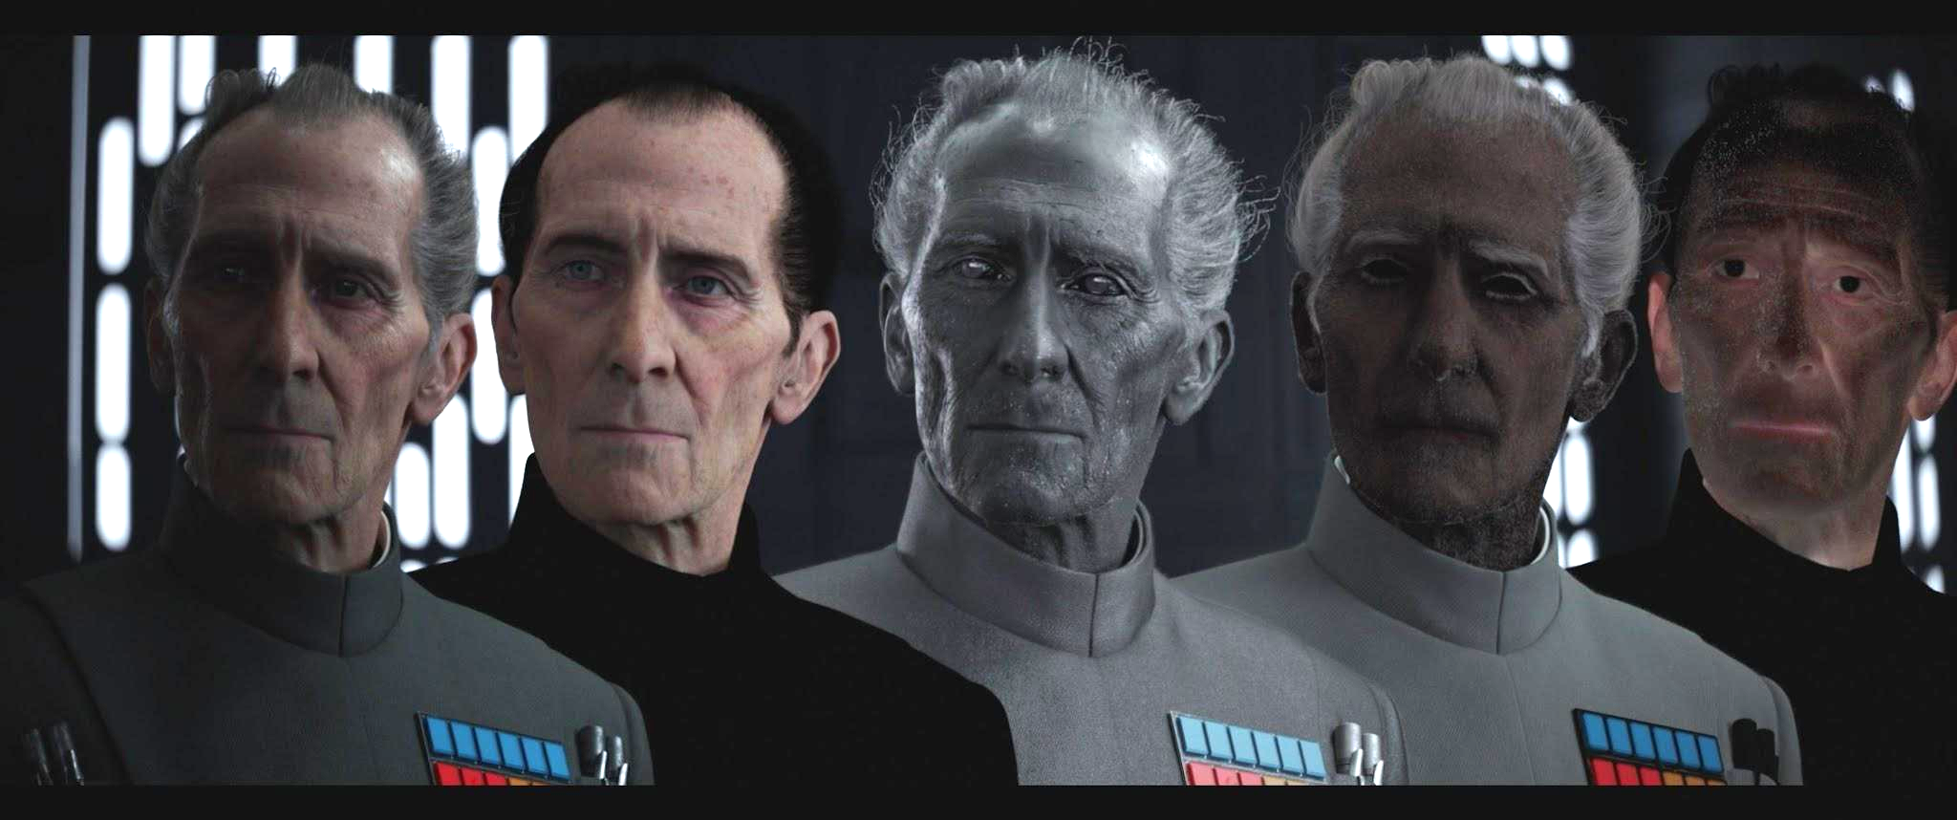
Image processing in films
The late Peter Cushing’s Grand Moff Tarkin performed by Guy Henry by Lucasfilm Ltd, retrieved from http://mediahorizontblog.hu/blog/virtualis_boncasztalon_osszerakott_sztarok. Copyright 2016 by Lucasfilm Ltd.

Slide 24
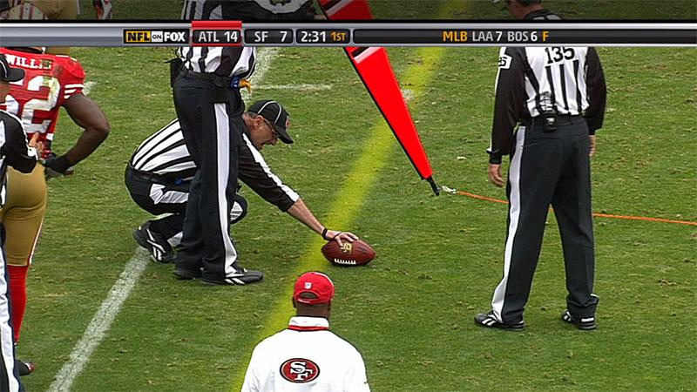
Image processing in sports
1ST & TEN® SYSTEM by SMT, retrieved from http://www.sportvision.com/1st-ten%C2%AE-system. Copyright 2017 by SMT.
Notes:
Multi-camera image processing

Slide 25
Image processing produces images,
computer vision produces understanding.

Slide 26
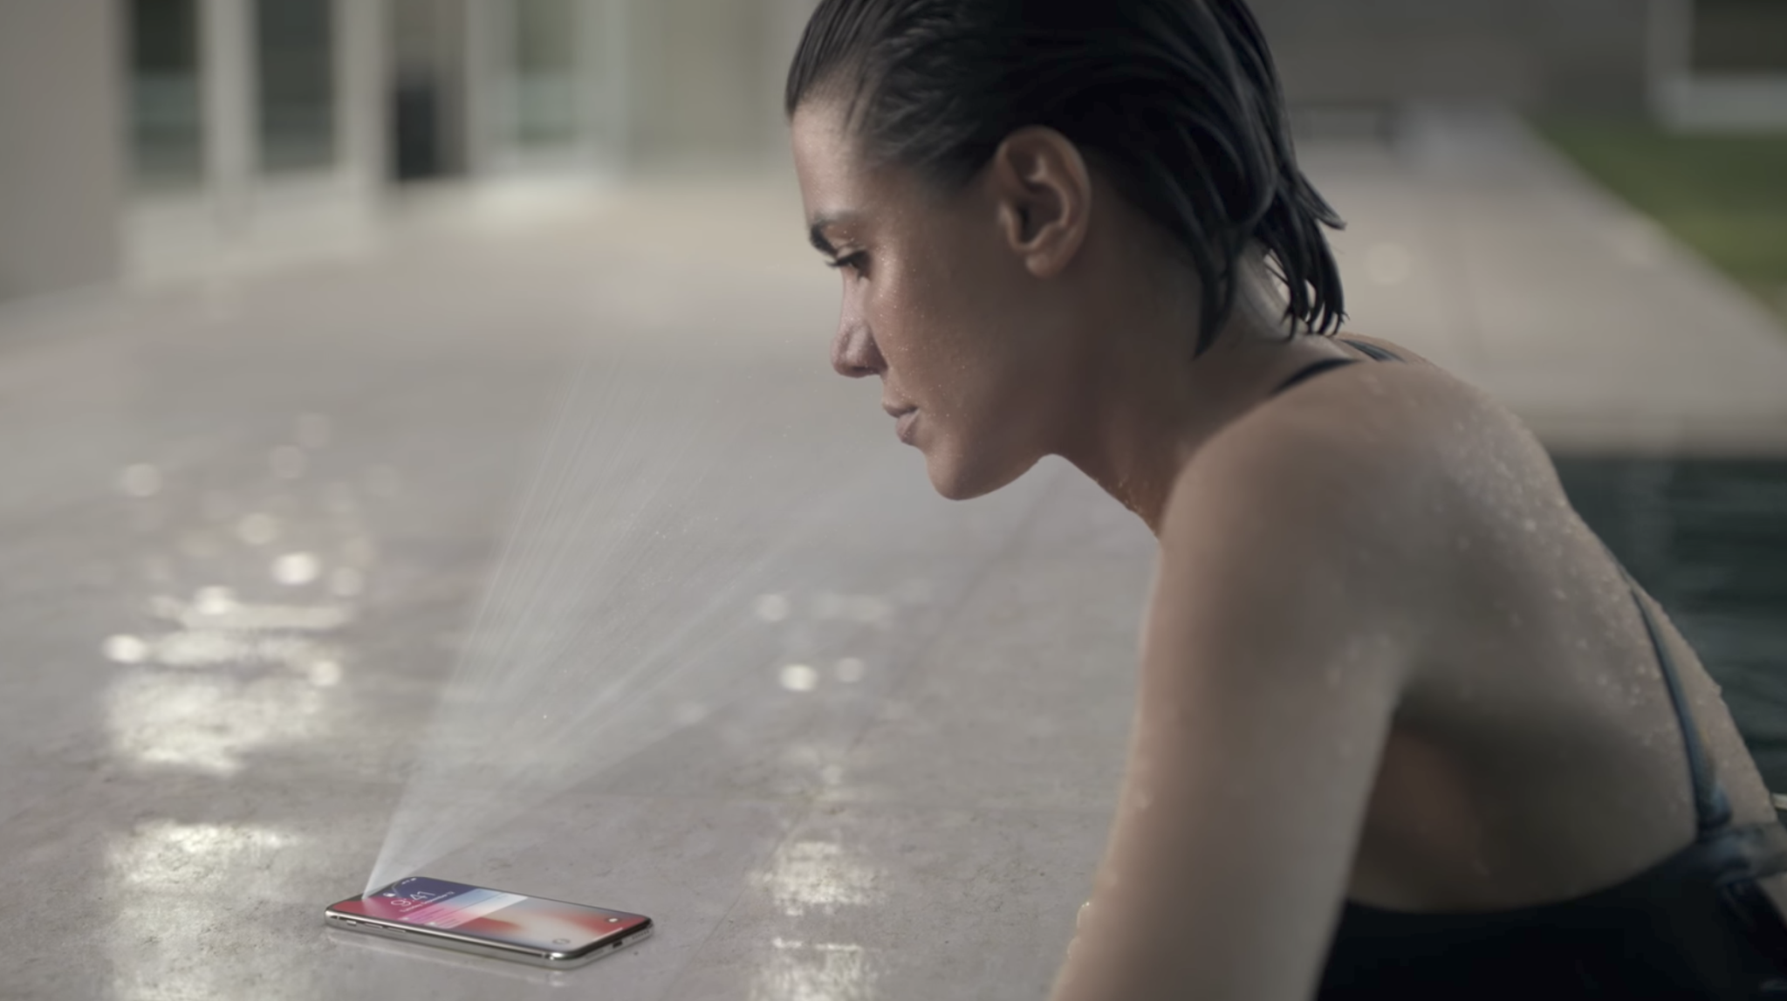
Computer vision in our smart phones
Facial ID on Apple iPhone X by Apple Inc, retrieved from https://www.apple.com/. Copyright 2017 by Apple Inc.
Notes:
Facial ID on the iPhone X

Slide 27
How can a computer understand?
top-down
vs. bottom-up
Facial ID on Apple iPhone X by Apple Inc, retrieved from https://www.apple.com/. Copyright 2017 by Apple Inc.

Slide 28
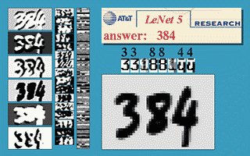
Computer vision in the post office
“Invariance and Multiple Characters with SDNN”, by Yann LeCun, retrieved from http://yann.lecun.com/exdb/lenet/dancing384.html. Copyright by Yann LeCun.
Notes:
Object character recognition

Slide 29
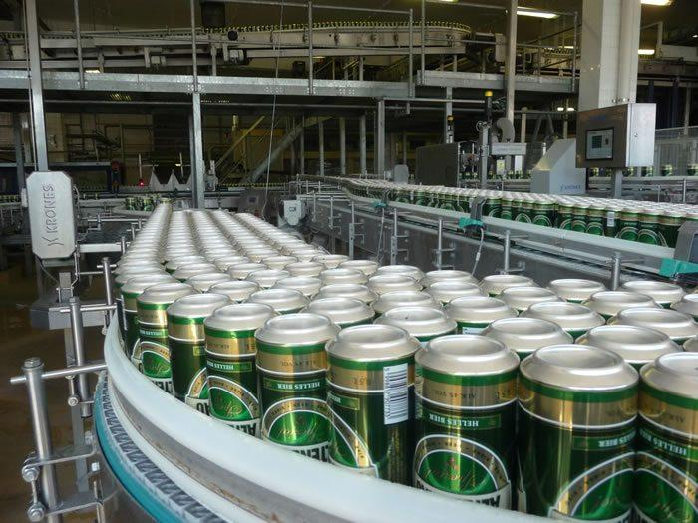
Computer vision in manufacturing
Beer manufacturing, by Construction Review, retrieved from https://constructionreviewonline.com/2014/06/east-africas-first-aluminium-can-production-unit-set-kenya/. Copyright 2017 by Construction Review.

Slide 30
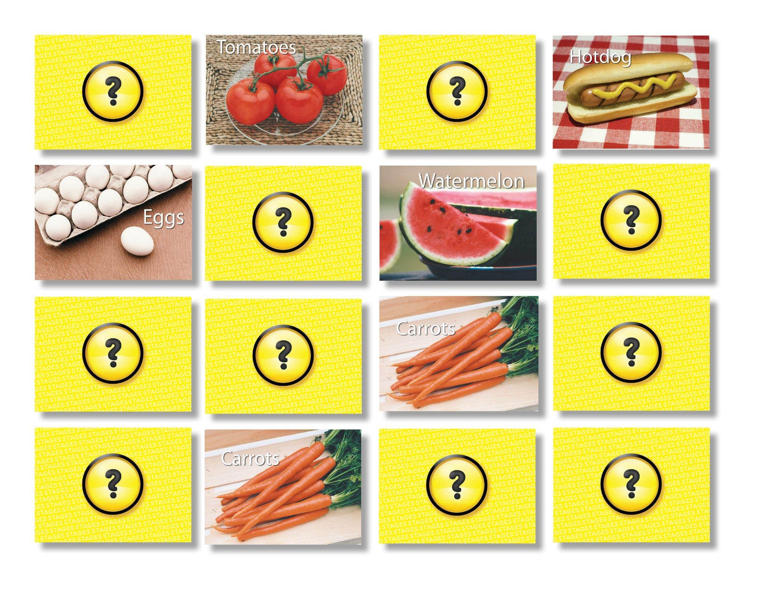
Computer vision with memory
Foods Memory Game by Stages Learning, retrieved from http://www.stageslearning.com/products/foods-memory-card-game. Copyright 2017 by Stages Learning.

Slide 31
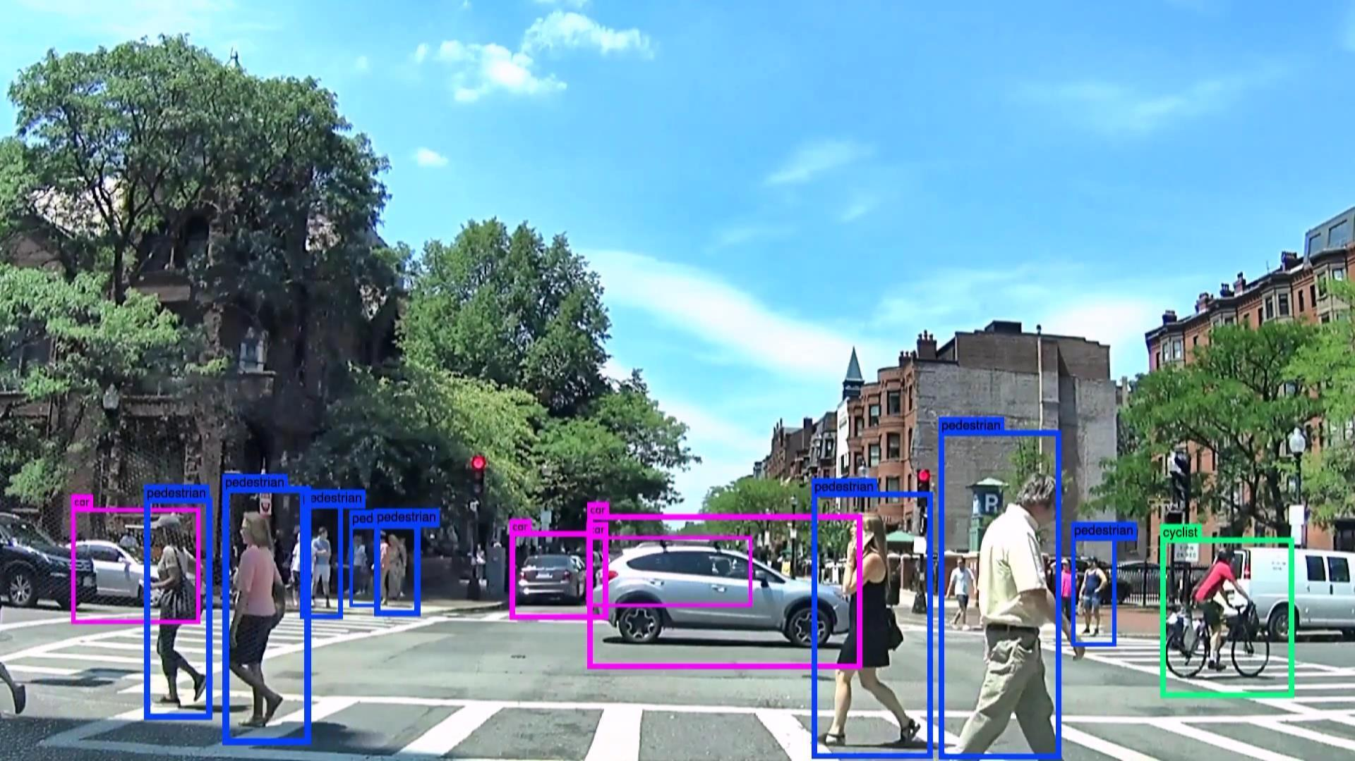
Computer vision in your car
Car on Newbury Street in Boston, Massachusetts by Neurala, retrieved from http://www.businesswire.com/news/home/20170118005301/en/Neurala-Announces-14-Million-Series-Bring-Deep. Copyright 2017 by Neurala.

Slide 32
Thank you!
Questions?
@jacobtrombetta
jacobtrombetta@gmail.com
Car on Newbury Street in Boston, Massachusetts by Neurala, retrieved from http://www.businesswire.com/news/home/20170118005301/en/Neurala-Announces-14-Million-Series-Bring-Deep. Copyright 2017 by Neurala.

Slide 33
MOOCs about computer vision and image processing
Udacity’s “Introduction to Computer Vision” presented by Georgia Tech
Udacity’s “Computational Photography” presented by Georgia Tech
Stanford’s “Convolutional Neural Networks for Visual Recognition”
Coursera’s “Deep Learning in Computer Vision”
Coursera’s “Fundamentals of Digital Image and Video Processing”

Slide 34
Links and papers about computer vision and image processing
Human vision, top down or bottom up?
Deep Learning for Computer Vision: Recurrent Neural Networks
What-when-how’s “Introduction to Image and Video Processing”

